Slide 1

Vijay Transtech Pvt. Ltd.
Virendra Borade (GM & BU Head)

Slide 2

VTPL Vision & Mission
Vision
“To be the most preferred System Integrator in India”
Mission
“ To drive System Integration business with complete transparency and build
customer trust by delivering best services with 100% satisfaction”

Slide 3

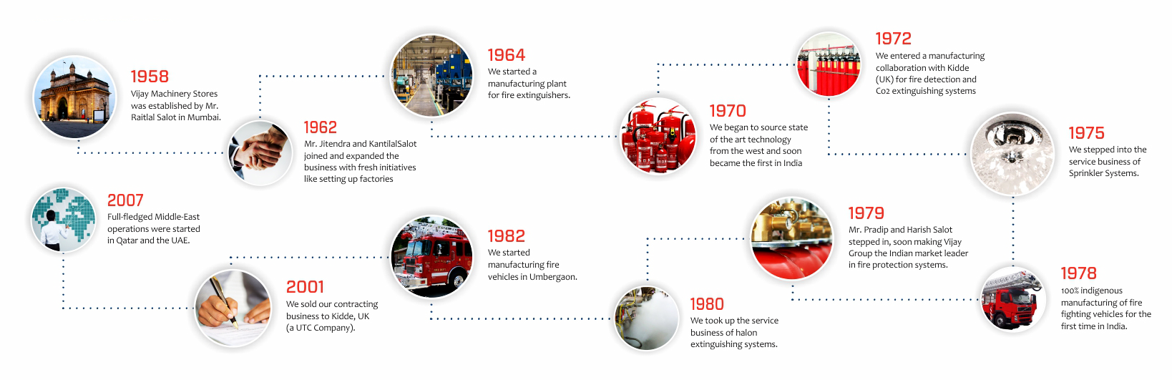
About Vijay Group
Vijay Group established in 1958 and become one of the largest companies in India in Fire Industry.
We have been Pioneers in providing and manufacturing innovative products in the Fire Industry.
We are well known for quality, honesty, customer satisfaction for more than 62 years.
We have 6 world class manufacturing facilities in India and project & Services team in all major parts of the country.
We also have a large company in Qatar doing various prestigious projects including new Doha International and even few FIFA Stadiums.
We were the first listed company in India for Fire Domain Industry in BSE

Slide 4

Brief about VTPL
                VTPL is part of 62 year old Vijay Group of companies
              Established in 2004 by Mr. Harish Salot.
              VTPL is blessed by young & Dynamic Team
            VTPL is a complete Design & Engineering System house for BMS, Safety & Security Solutions.
          VTPL has a very strong technical as well as project management team.
        Strong after sales support & online monitoring of service resolutions
      Ability to execute critical projects like pharmaceuticals & hospitality
    Strong financial /organizational infrastructure to execute large size projects.
  ISO Certified and SAP/ERP driven operations
Certified Engineers in IBMS Domain by all OEMs
Award winning System Integration company

Slide 5





VTPL Philosophy
We believe in
        Connect with the Client in understanding their problems & requirement
      Create a mutually beneficial product & solution offerings
    Collaborate with various stake holders for smooth integration
  Scale up the business opportunity for client as well as ourselves
Connect Create Collaborate Scale-up

Slide 6

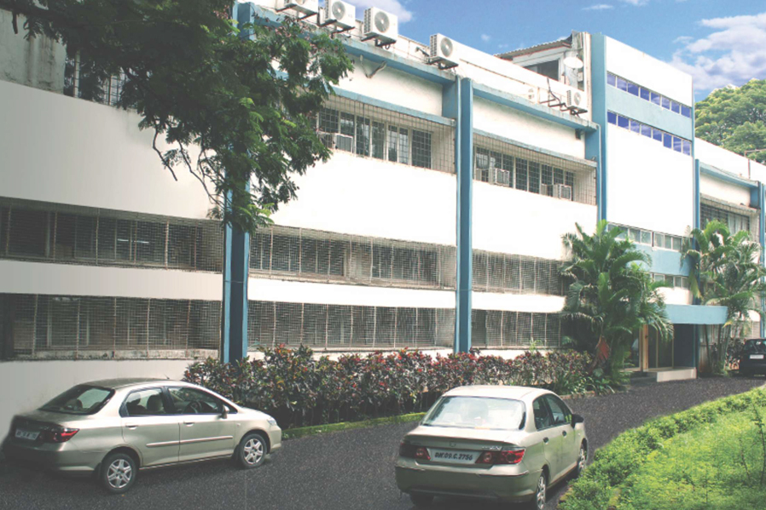
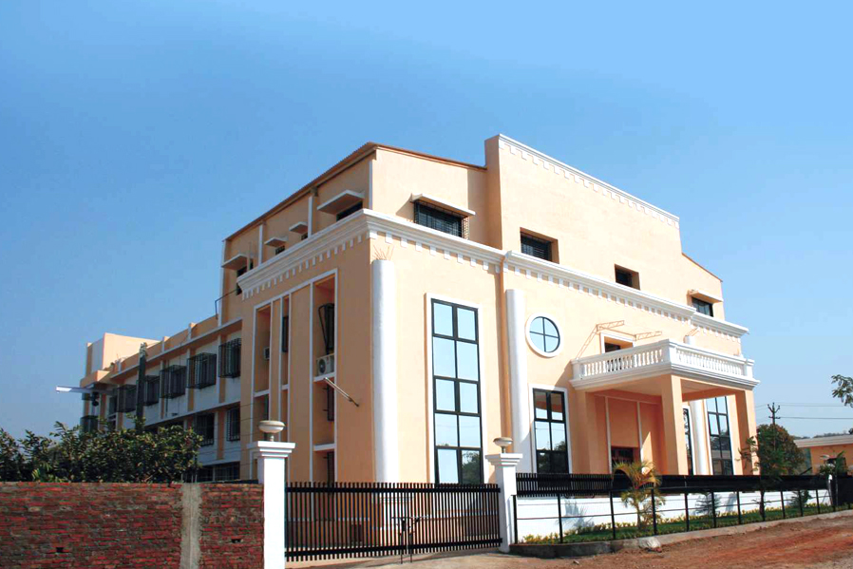
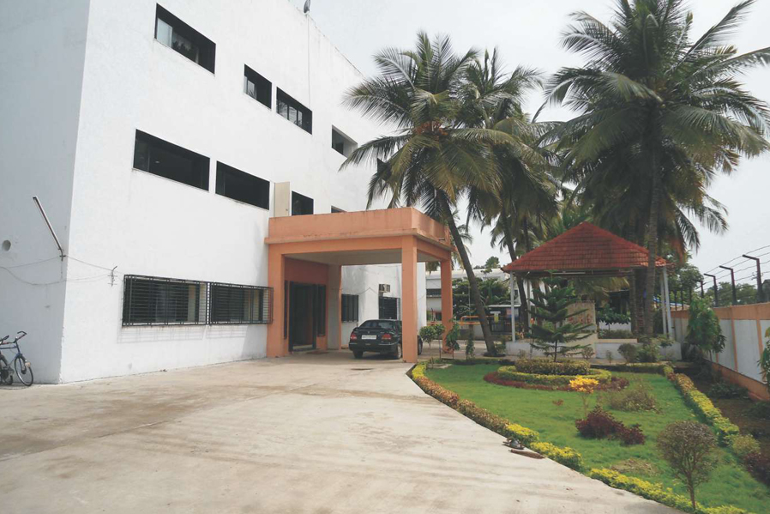

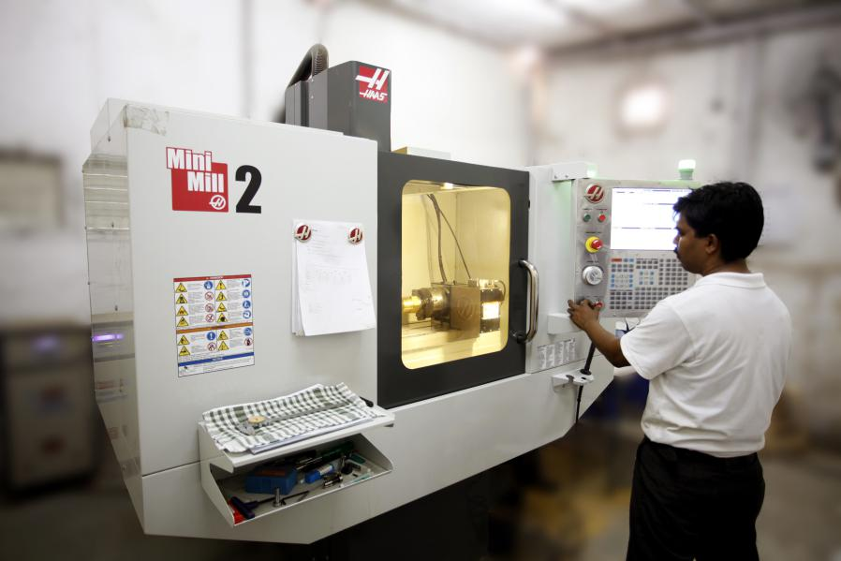
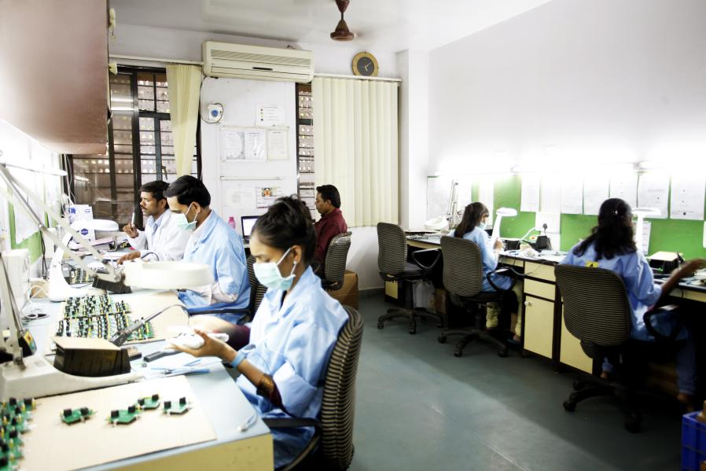
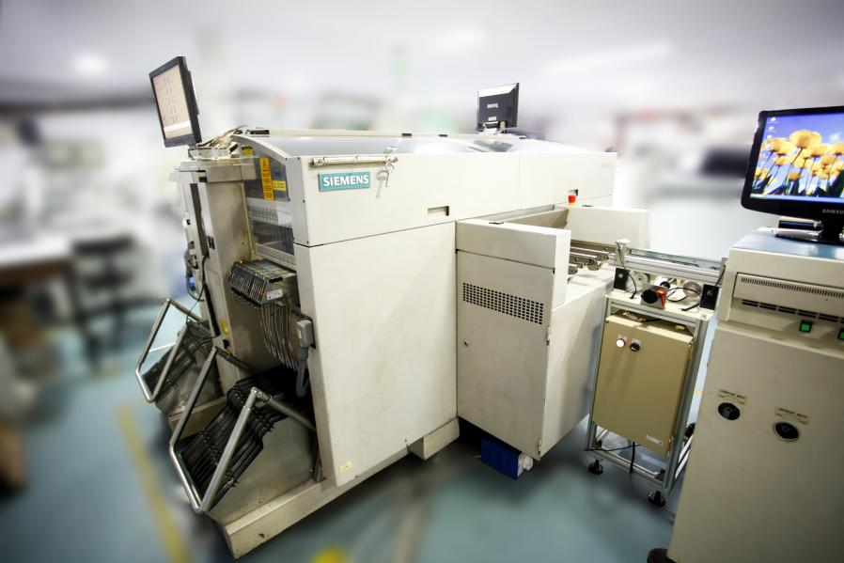
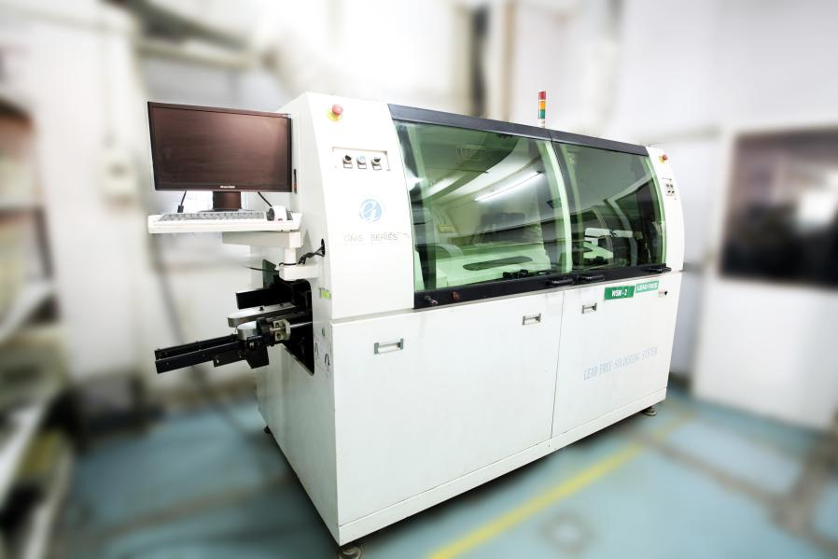
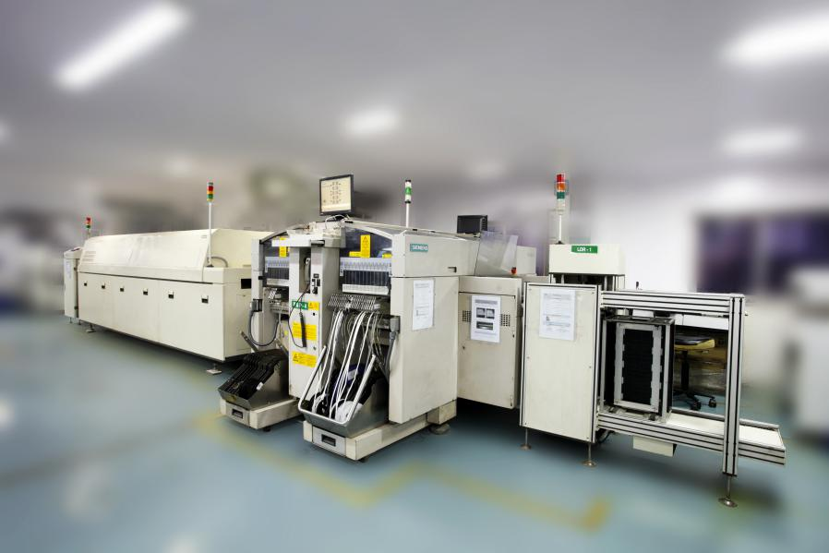
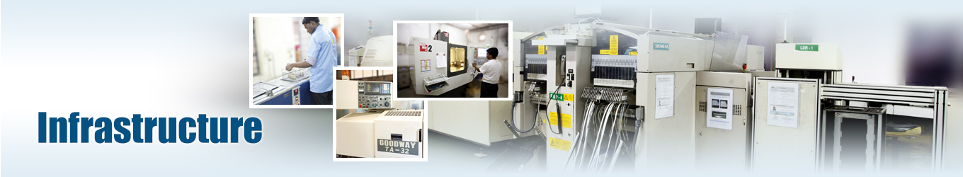
VTPL Infrastructure
In House design team
SAP/ERP Operations
ISO Certified organization
Factory set-up
Own Testing Facility
Own Engineering Tools
State of the art office
Advance Machinery
Online Service call tracking
Certified Engineering Team
Skilled Labour & Supervisor
Strong Project Management Team
Advance Logistic Support
VTPL

Slide 7

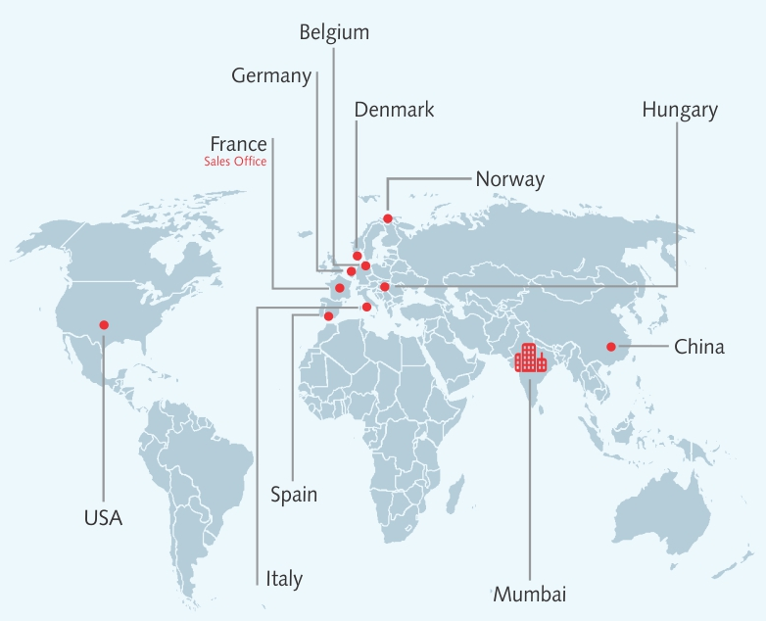

VTPL Global presence
We have HQ in Mumbai
VTPL in France
Partners in USA, Spain, Italy, China, Hungary, Norway, Denmark , Belgium, Germany etc.

Slide 8

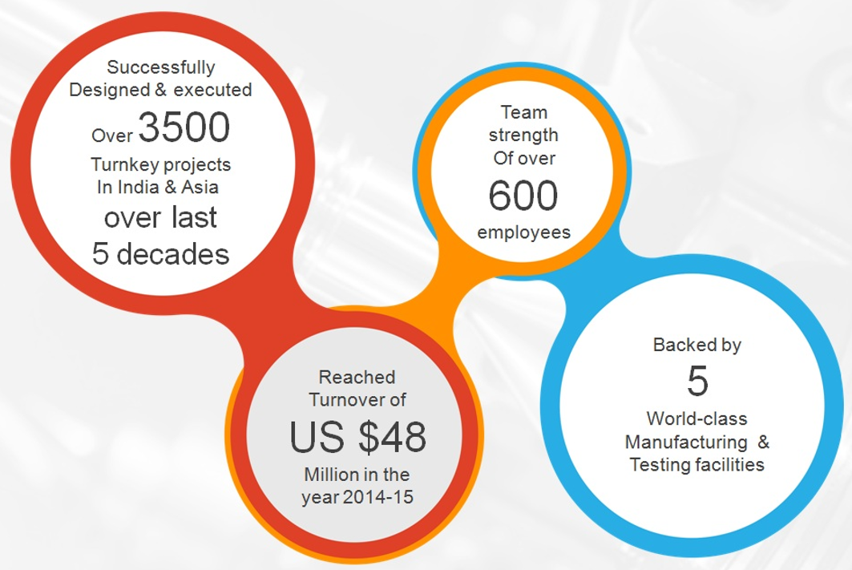
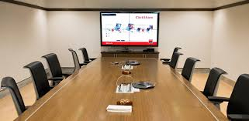
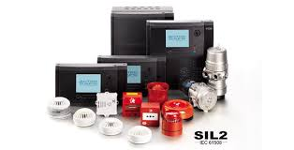
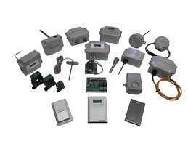
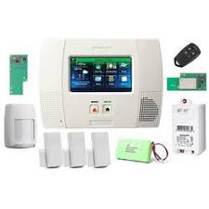
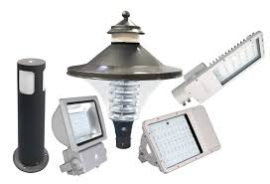
VTPL Services
Fire Alarm System & Fire Suppression with complete fire graphics
Building Management System & Maintenance Management System
Energy Management System & Energy Dashboards
Environment Management System & Analytics
Lighting Management System & Humancentric lighting.
Security system like Bollards, Turnstile, Flap barriers & CCTV System
Home Automation, Home Theatres and Mood Lighting
Passive Fire Protection , Gas Suppression, VESDA and specialized fire products.
BTU Metering, Water flow metering & HVAC Products IOT Solutions for complete building services
Board room solution, Unified Communication systems etc.

Slide 9









VTPL Partners
SCHNEIDER ELECTRIC
GREYSTONE ENERGY
KAMSTRUP BTU
TYCO INDUSTRIES
UNITED TECHNOLOGIES
IOTOMATION LLP
AUTRONICA FIRE & SECURITY
HONEYWELL AUTOMATION

Slide 10

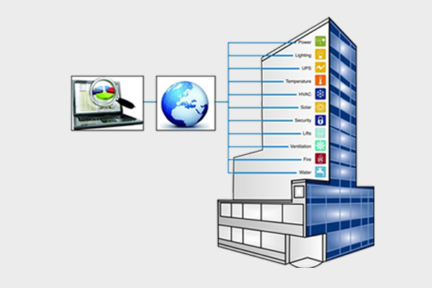











System Integration
              Power monitoring & UPS
            Lighting Automation & Control
          Security System & CCTV surveillance
        Fire Detection & Suppression
      Water Management, STP, WTP etc.
    Lift, DG, Solar, HVAC control & monitoring
  Parking Management & Visitor Management
Landscape & Façade, Drip irrigation system
Environment Monitoring system (EMS)
Complete Building Management System

Slide 11


System Architecture
          We provide three layer system architecture for all our clients
          with complete cyber security feature built in our software.
          Management Layer ( for top level)
        Supervisory Layer ( for mid level)
      Field Layer ( for operator level)
Our software are most advance having and user friendly. Controllers are IP enable having native BACnet compliant and field devices are most robust for any type of applications

Slide 12


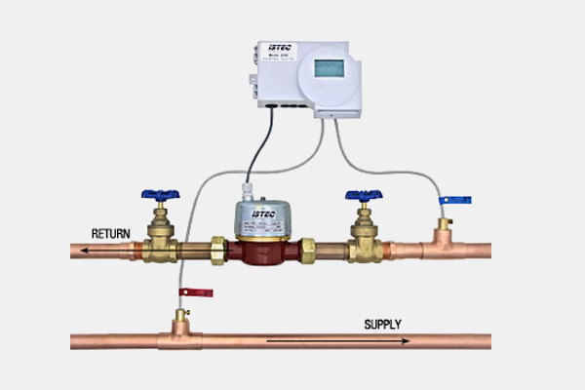
Kamstrup’s BTU Metering
                BTU Metering system of Kamstrup is one of the most advance energy monitoring system in the world
              It measure correctly and deliver reliable consumption data still after more than 15 years in operation.
            BTU meters can be mains or battery powered. The battery lifetime lasts for up to 16 years.
          Low operational costs and a low total cost of ownership without compromising the data reliability.
        Improved measuring stability over the entire product lifetime.
      Ultrasonic BTU Meters has been extremely reliable in terms of accuracy over time.
    Plug & Play Type- you can change the communication method without changing the meter
  Fast configuration and easy installation
Reduces manual work and eliminates meter reading errors.
cLOUD
BTU
BILLING

Slide 13

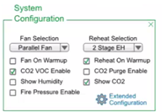
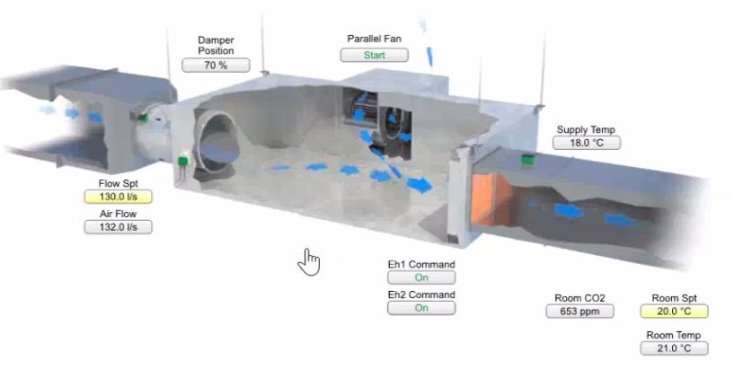
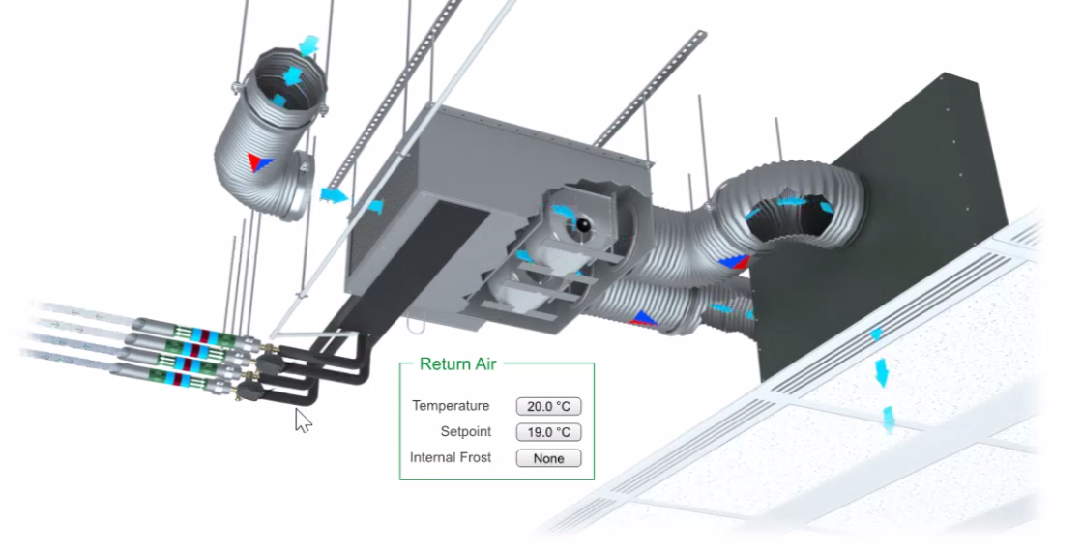
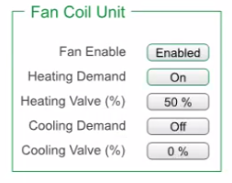
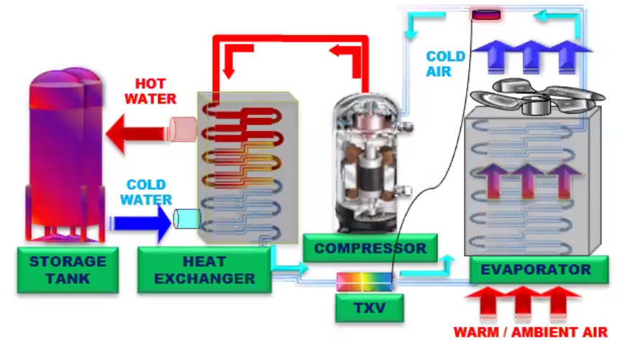
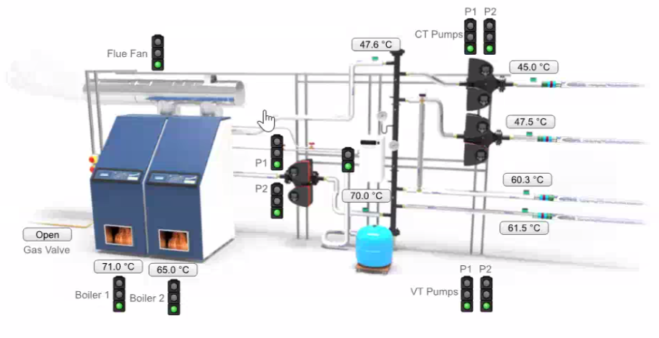
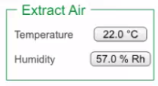
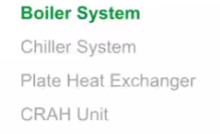
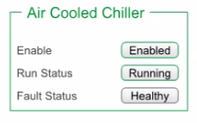

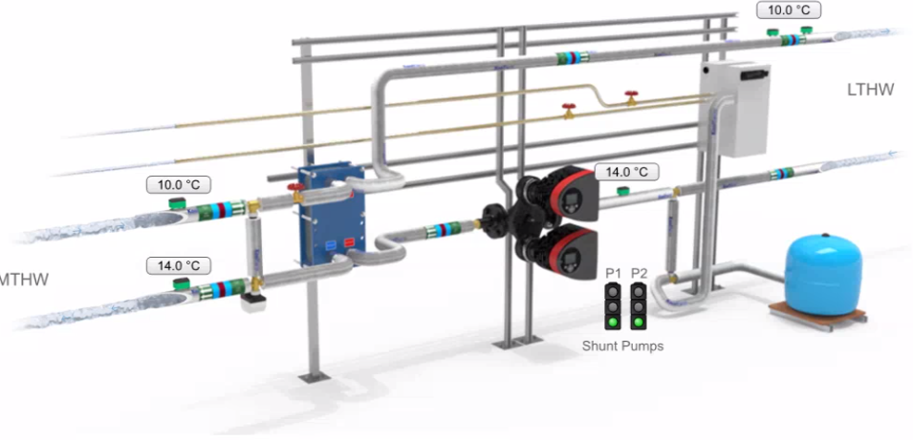
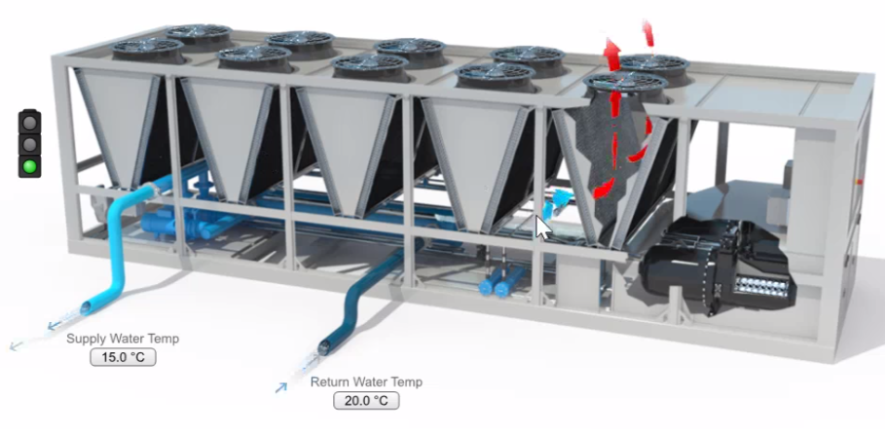
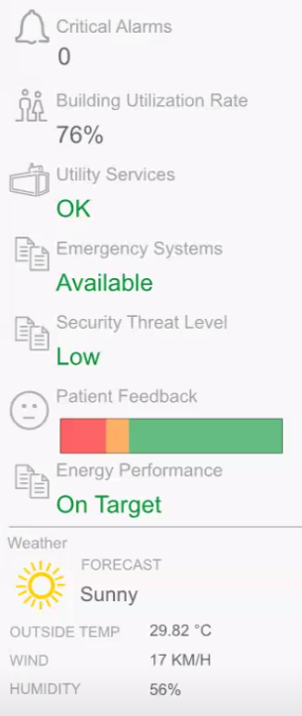
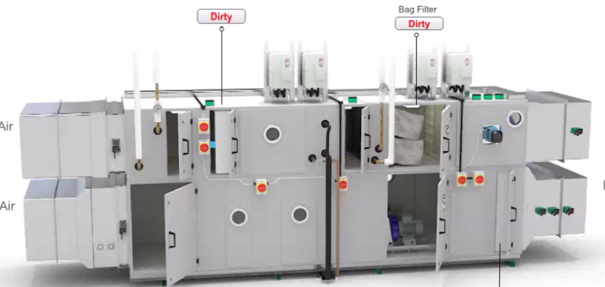
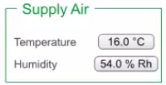
BMS Graphics

Slide 14


























VTPL Valued Clients
80% business derived from retention
&
20% business from new Clients
“99.99% customer satisfaction”

Slide 15

Organization Chart
Harish
Salot
Vijay
Kumar
Accounts
Head
Praful
Design & Estimation
Vimal
Harshil
Sandip
Bhosale
Client Billing
Gajendra
Design
Namrata
Estimation
Virendra
BU Head
New Sales Head
Faiz
Project
Head
Ravi
Kharava
Design
Handover
Docs
Yashvant
Mokal
Service Head
Sachin
Patade
Key Project
Sun Pharma
etc
Imtiyaz Ahemad
Key Project
NTPC/IOCL etc
Ravi
Sharma
Tech Support
BMS/FAS
Kashyap
Regional
Sales Head
Suresh
Product
Sales
Head
Noor
Mohammed
Mumbai
Santosh
On Call
Services
Javed
Sumara
BMS
Projects
Sagar
Solanki
FAS/ACS/PA
Projects
Rahul
Gamit
FAS/BMS
Projects
Shahnavaz
On Call
Services
Romesh
Parekh
Collection
Followup
Dhanajay
Singh
Site Engg

Slide 16

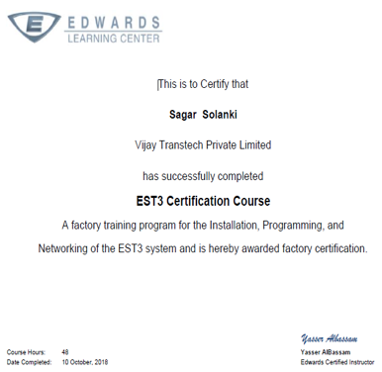
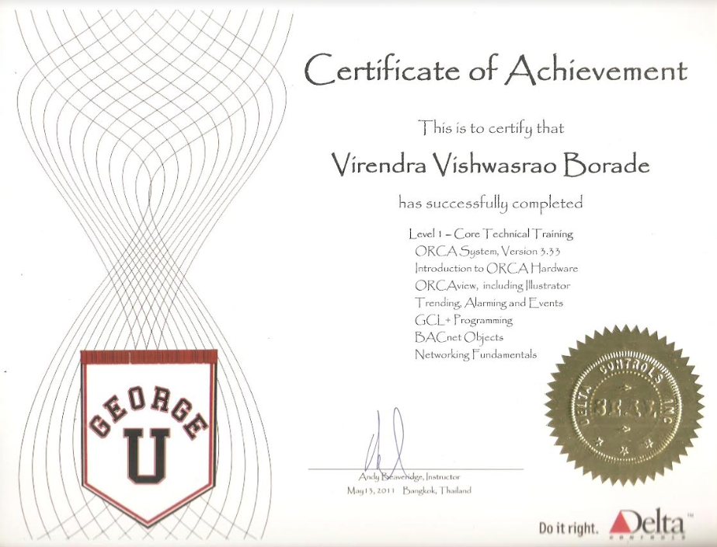
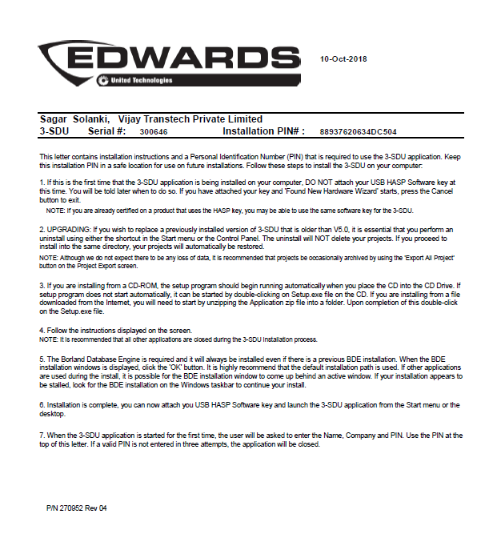
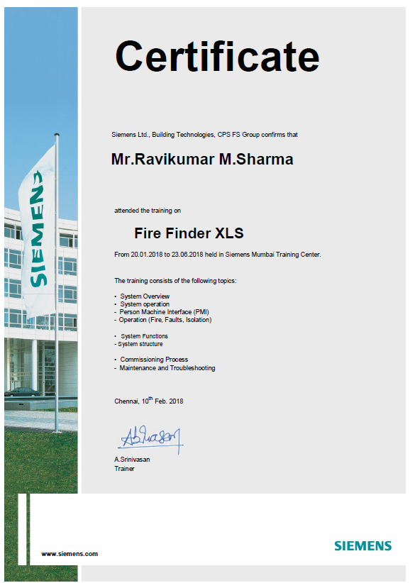
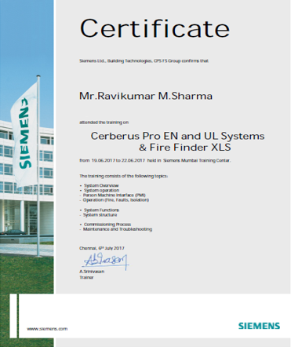
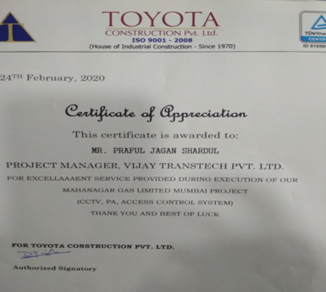
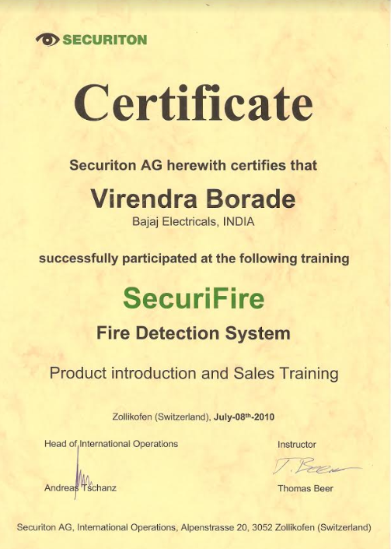
VTPL Certification

Slide 17

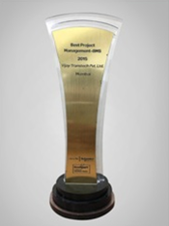
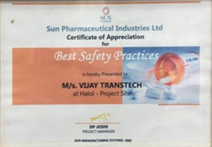
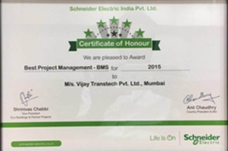
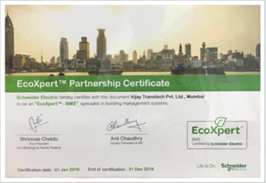
Honors & Awards

